Slide 1

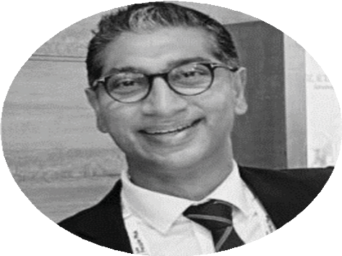





Throughout Sachin’s working career, he’s woven success stories across diverse spheres, fuelled by a robust entrepreneurial spirit and an unwavering will to succeed. Sachin’s journey includes leadership roles in prominent Recruitment and Staffing Consulting firms and Investment Banks, where he has contributed to the success of over 100,000 professionals, helping them realize their dream jobs.
On top of “three across” leadership role, Sachin is passionately mentoring Boutique talent & Re-commerce firms, and guiding individuals through their unique professional and personal journeys. The joy lies in fostering growth and achieving milestones collectively.
Sachin Jolly
Founder & CEO

